Slide 1




Core Java
Lesson 1—Introduction to Java

Slide 2


Learning Objectives
At the end of this lesson, you should be able to:
Discuss Java technology
Discuss object-oriented programming (OOP) Explain the fundamentals of Java language
Discuss primitive data types and wrapper classes in Java
Set up Java and Eclipse on your machine Write and run your first Java program

Slide 3
Core Java
Topic 1—Introduction to Java

Slide 4
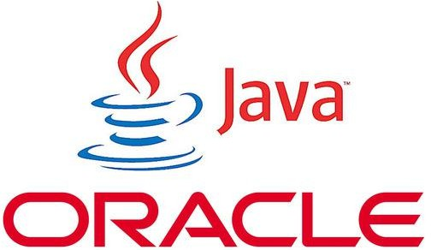

What Is Java?
A programming language and computing platform for developing
application software that can run on any device
Used in a wide variety of platforms, from game consoles, laptops, and mobile phones to datacentres, enterprise servers, and scientific supercomputers
Since Java has its own runtime environment—Java Runtime Environment ( JRE) and application programming interface (API), it is considered a platform.

Slide 5

History of Java
The search for a “Java” like language started in 1990 when there
was a need for a portable code which can run on any device.
James Gosling (Sun Microsystems) developed Java in 1995.
Java is now a subsidiary of Oracle Corporation.
Today, Java is used almost everywhere. The reasons are plenty.

Slide 6
Why Java?
Simple and easy to read language
Well-defined libraries created through modifications from the existing C libraries
Purely object-oriented language (OOP)
Used in top mobile OS, for example
Android uses Java for coding
Distributed, interpreted, robust,
and secure
Provides strong networking infrastructure for server side computing
Portable because you can write it once and run it everywhere
Platform independent

Slide 7

Types of Java Applications
Standalone Application
Web Application
Enterprise Application
Mobile Application

Slide 8
Types of Java Applications
Standalone Application
An application that needs to be installed on every machine, such as set-top box, antivirus, and media player

Slide 9
Types of Java Applications
Web Application
An application that runs on the server side and creates dynamic page

Slide 10

Types of Java Applications
Enterprise Application
A business application that has high level of security, load balancing, and clustering, such as banking application
Developed using Enterprise Java Bean (EJB)

Slide 11
Types of Java Applications
Mobile Application
An application for mobile devices
Currently, developed using Android and
Java Micro Edition (Java ME)

Slide 12









Java Editions
Java Standard Edition (SE)
Java Enterprise Edition (EE)
Java Micro Edition (ME)

Slide 13
Java Editions
Java SE
Desktop/servers and embedded environment
A standard edition core Java programming platform
Contains all Java libraries
Allows development and deployment of Java applications
on desktops, servers, and embedded environments
Used to build standalone applications
Latest version—Java SE 8u 31

Slide 14


Java Editions
An enterprise edition that lets you develop large-scale, multi- tiered, scalable, reliable, and secure network applications
Java EE
Web and enterprise
applications
Allows Application Programming Interface (API) to develop distributed applications (apps) that follows client-server model
Distributed apps are applications that can run on multiple
computers within a network.
Portable—allows an application hosted at one place to be
accessed by users across the world over the Internet
Latest version—Java EE 7

Slide 15
Java Editions
Java ME
Mobile applications
A micro edition which lets you develop programs for mobile application devices
Consists of programming specifications and a special virtual machine that allows a Java ME encoded program to run on mobile devices
Latest version—Java ME 8.3

Slide 16
Differences between Editions
SE API Packages
EE API Packages
ME API Packages
java.applet
java.awt
java.lang
java.rmi
java.sql
java.util
javax.annotation
javax.ejb
javax.jms
javax.persistence
javax.servlet.http
javax.servlet.jsp
Device Access API
System Configuration API
OAuth2 API
JSON API
HTTP Client API
Security API

Slide 17
Latest Version—Java 8
Java 8 is the latest version of Java, which was released in March, 2014.
It allows developers to develop applications across a wide range of scenarios, from the
smallest embedded Internet of Things (IoT) devices to enterprise servers in the cloud.
It includes upgrades to Java programming, Java virtual machine ( JVM), tools, and libraries.

Slide 18
Latest Version—Java 8 (Contd.)
The features of Java 8 are the following:
Java 8 Date/Time API
Lambda Expressions
Method References
Functional Interfaces
Stream API
Base64 Encode Decode
Default Methods
forEach method
Collectors
StringJoiner
Optional class
Nashorn JavaScript
Parallel Array Sorting
Type Inference
Method Parameter Reflection
Type annotations and repeating annotations
Java Database Connectivity ( JDBC) improvements

Slide 19
Core Java
Topic 2—Object-Oriented Programming (OOP)

Slide 20
Object-Oriented Programming
OOP is a programming language model, organized around “objects” rather than “actions” and “data” rather than “logic.”
It simplifies software development and maintenance by providing the following important
concepts:
Class
Object
Inheritance
Encapsulation
Polymorphism
Abstraction

Slide 21
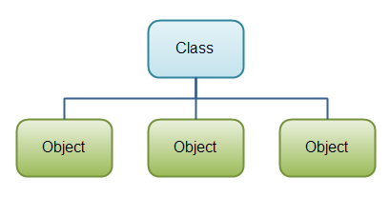
Object-Oriented Programming
A class is a blueprint or prototype for creating objects, providing initial values for variable state, and implementing behavior.
Class
access_specifier class ClassName
{
/*
class consists of
a)class level or global variables b)objects
static and non static methods
constructors
inner classes
*/
}
Object
Inheritance Encapsulation Polymorphism Abstraction

Slide 22
Object-Oriented Programming (Contd.)
An object is a software bundle of related state and behavior. Software objects are often used to model the real-world objects.
Class
Inheritance Encapsulation Polymorphism Abstraction
Object
An object is an entity that has “variable” and “method.”
An object has three characteristics:
State: Data (value) of an object
Behavior: The behavior (functionality) of an object, such as deposit, withdraw
Identity (ID): Typically implemented via a unique ID
The value of the ID is not visible to the external user. But, it is used internally by the JVM to identify each object uniquely.

Slide 23
Object-Oriented Programming (Contd.)
Inheritance provides a powerful and natural mechanism for organizing and structuring classes.
In Inheritance, subclasses:
Object
Class
Encapsulation Polymorphism Abstraction
Inherit attributes and services from their superclass
May add new attributes and services
Reuse the code in the superclass
Provide specialized behaviors (overriding and dynamic binding)
Partially define and implement common behaviors (abstract)
Inheritance
Class A
Class A
Class A
Class B
Class B
Class B
Class C
1. Single type
3. Hierarchical type
Class C
2. Multilevel type

Slide 24
Object-Oriented Programming (Contd.)
Example of inheritance:
Object
Class
Encapsulation Polymorphism Abstraction
Shape
draw ()
class Subclass-name extends Superclass-name
{
//methods and fields
}
Inheritance
Line
draw ()
The keyword “extends” implies that you are making a new class that descends
from an existing class.

Slide 25
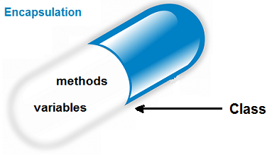
Object-Oriented Programming (Contd.)
Encapsulation is a mechanism for wrapping the variables and methods together as a single unit.
In Encapsulation, variables from a class will be hidden from other outer classes and can only be accessed by the method of same class.
Using Encapsulation:
Object
Class Inheritance
Polymorphism Abstraction
A field in a class can be made read-only or read and write only via the methods and not directly
A class can control the elements in it
Encapsulation

Slide 26
Object-Oriented Programming (Contd.)
Polymorphism is the ability of an object to take on many forms.
Object
Class Inheritance Encapsulation
Abstraction
Shape
draw ()
Line
Triangle
Rectangle
Circle
draw ()
draw ()
draw ()
draw ()
There are two types of Polymorphism:
Compile time Polymorphism
Runtime Polymorphism
Polymorphism
It can be performed in two ways:
Overloading
Overriding

Slide 27
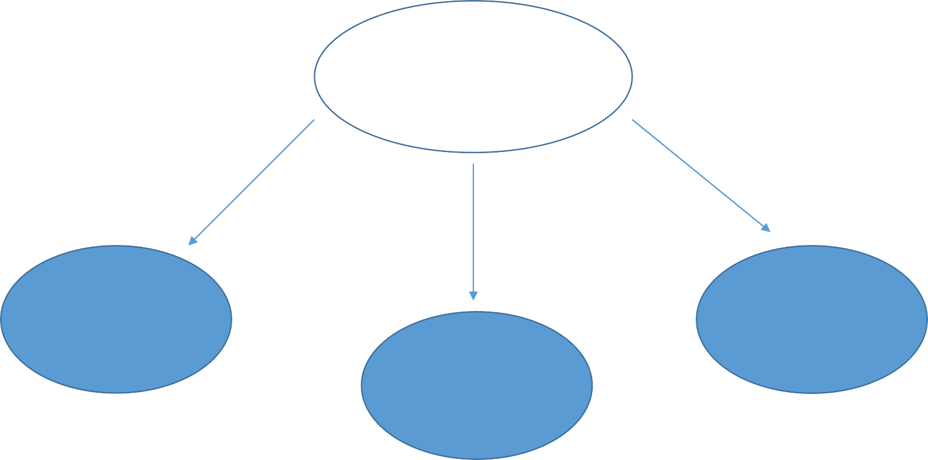
Object-Oriented Programming (Contd.)
Hiding internal details and showing functionality is known as abstraction. For example: Employee of a company with hidden mobile number, salary, and address.
In Java, we use abstract class and interface to achieve abstraction.
Object
Class Inheritance Encapsulation Polymorphism
Abstraction
Employee
Mobile number
Address
Salary
Abstraction

Slide 28
Core Java
Topic 3—Fundamentals of Java Language

Slide 29
Fundamentals of Java Language
Core Elements of Java Language
Classes and Objects
Methods
Variables
Class has two components:
Class declaration—It contains the class name and the access modifier. The access modifier defines the accessibility of the class.
Class body—It comes after declaration, and it contains functions and variables.
Object is an instance of a class. When a program is run, objects are created to do the task.

Slide 30
Fundamentals of Java Language
Core Elements of Java Language
Classes and Objects
Methods
Variables
A method is a subprogram that contains the logic of the application. It acts on data and often returns a value.
It is referred to by name and can be called by its name. Each method contains the following:
Declaration—includes the method name, return type, parameter, and
accessibility
Body—contains information that determines the behavior of the object
public static void main (String[] args)
{
statement;
Method1
method1(); statement; method2();
statement;
Method2
}

Slide 31
Fundamentals of Java Language
Core Elements of Java Language
Classes and Objects
Methods
Variables
Variable is a reserved memory that temporarily stores a data value and thus has a data type. It can be either declared or inferred. It adheres to type constraints.
There are four types of variables in Java:
Instance/non-static variables—a variable that belongs to an object
Static variables—a variable that belongs to a class
Local variables—a variable declared inside methods, constructors, or blocks
Parameters—a variable that is passed to a method when the method is called
Example of non-static variable
public class MyClass
{
public static void main(String[] args) {
int number = 5;
number = number + 10;
}
}

Slide 32
Fundamentals of Java Language
Components of Java
Java Development Kit (JDK)
Java Runtime Environment (JRE)
Java Virtual Machine (JVM)
JDK contains JRE and development tools necessary to compile, document, and package Java programs.
JDK
Set of Libraries Example: rt.jar
Other Files
Development Tools Example: Javac and java
Java Virtual Machine ( JVM)
JRE

Slide 33
Fundamentals of Java Language
Components of Java
Java Development Kit (JDK)
Java Runtime Environment (JRE)
Java Virtual Machine (JVM)
JRE is a runtime environment in which Java bytecode is executed. It contains all the class
libraries and other files that JVM uses at runtime.
Set of Libraries
Example: rt.jar
Other Files
Java Virtual
Machine ( JVM)
JRE

Slide 34

Fundamentals of Java Language
Components of Java
Java Development Kit (JDK)
Java Runtime Environment (JRE)
Java Virtual Machine (JVM)
JVM is an abstract machine. It is a specification that provides runtime environment in which Java bytecode can be executed.
Unlike other languages, Java “executables” are executed on a CPU that does not exist.
Java Virtual Machine ( JVM)

Slide 35


Java Architecture
Class Loader Byte Code Verifier
Java Class Libraries
Java Source Code (.java)
File System/ Network
Class Loader Byte Code Verifier
Class Loader Byte Code Verifier
Java Compiler
(javac)
Java Virtual Machine ( JVM)
Java Byte Code is moved locally or through network
Runtime System
Java Byte Code (.class)
Operating System (OS)
Hardware
Compile Time
Run Time

Slide 36
Core Java
Topic 4—Primitive Data Types and Wrapper Classes in Java

Slide 37
Primitive Data types
Primitive data types are basic data types in Java language.
There are 8 primitive data types:
int
short
long
byte
float
double
char
boolean
4 bytes
2 bytes
8 bytes
1 byte
4 bytes
8 bytes
Behavior is same as
in C++
Unicode encoding (2 bytes)
{true, false}
Primitive type always begins with a lowercase letter.

Slide 38
Wrapper Classes in Java
Wrapper class in Java provides the mechanism to
convert primitive into object and object into primitive.
Data Type
The eight classes of java.lang package are known as
Primitive
Non-
primitive
wrapper classes in Java.
Boolean
Character
Byte
Short
Integer
Long
Float
Double
String Array etc.
Boolean
Numeric
Character
Integral
Integer
Floating-point
boolean
char
byte
short int long
float
double

Slide 39
Core Java
Topic 4—How to Set Up Java and Execute Java Program

Slide 40

Setting Up Eclipse
To write your Java programs, you need Integrated Development Environment (IDE), such as Eclipse.
There are many more IDEs available in the market. For now, let us consider Eclipse IDE.
Eclipse is a Java IDE developed by Eclipse open-source community.

Slide 41
Setting Up Eclipse (Contd.)
To set up Eclipse IDE in Windows machine:
Download and install the Eclipse IDE.
Configure the Eclipse Plugin to start under JDK 1.8.
Set up the Java environment.
To set up the Java environment in Eclipse:
Right click My Computer
Select Properties>Advanced system settings>Environmental Variables
Under User Variables, click New. A popup window will appear
In the popup window, define the variable name and its value
Value is the complete path to where you have saved your JDK. For example: C:\Program
Files\Java\jdk1.8.0_16\bin;.; path

Slide 42
Setting Up Eclipse (Contd.)
Test the variable by opening the command prompt window and type “javac” to launch the compiler
with the command.
The command prompt window should show the list of things supported by Java.
Restart your machine.
Start Eclipse and do the following:
Update the Installed JREs
Install the Maven Eclipse Plugin
Configure the Maven Plugin
Set up a DOS Shell in Eclipse

Slide 43
Setting Up Java and Executing Java Program
To set up JDK on Windows machine:
Download and install JDK and JRE by running the downloaded installer.
Include JDK’s “bin” Directory in the PATH.
Verify the JDK Installation.
Write a “Hello-World Java” Program
class Hello
{
public static void main(String[] args){
System.out.println(“Hello World !!!”);
}
}
C:\javac Hello.java
( compilation creates Hello.class )
C:\java Hello
(Execution on the local JVM)
5. Compile and Run the Hello World Java Program.

Slide 44

Key Takeaways
Java is both a programming language and computing platform for developing application software that can run on any device.
Java is platform independent—Write Once and Run Anywhere (WORA).
Java programming can be used to develop standalone, web, enterprise, and mobile applications.
Java is an Object-Oriented Programming language.
Classes and objects, methods, and variables are some of the core elements of
Java.
JVM, JRE, and JDK are components of Java.
Primitive data types are basic data types in Java language.
Wrapper class in Java provides the mechanism to convert primitive into object and object into primitive.

Slide 45


Quiz

Slide 46

QUIZ 1
Which of these is needed for Java developer to develop the Java app?
a. jdk
b.
apk
c.
jar
d.
jre

Slide 47

QUIZ 1
Which of these is needed for Java developer to develop the Java app?
a. jdk
b.
apk
c.
jar
d.
jre
The correct answer is a and d.
jdk and jre is needed to develop the Java app.

Slide 48
QUIZ 2
Java is currently part of:
a. Sun Microsystems
b.
Microsoft
c.
Oracle
d.
Sun Organization

Slide 49
QUIZ 2
Java is currently part of:
a. Sun Microsystems
b.
Microsoft
c.
Oracle
d.
Sun Organization
The correct answer is c. Oracle
Currently Java is a part of Oracle.

Slide 50

Thank You

